Slide 1
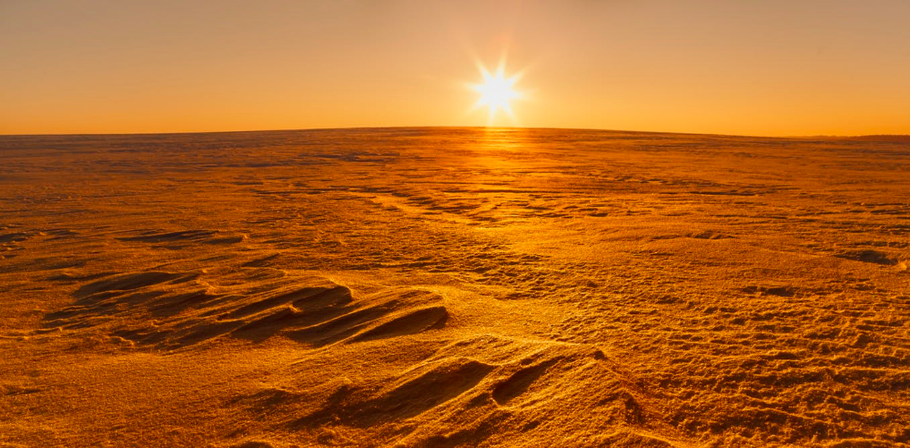

MARS AT LOW OBLIQUITY
ETIENNE DUPONT
18/06/2018

Slide 2
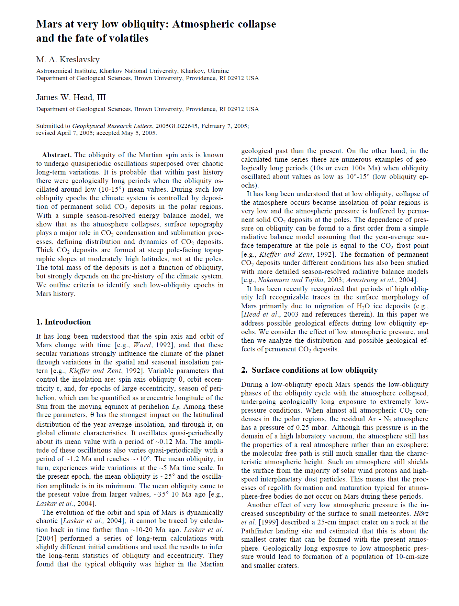
Motivations
At low obliquity, very thin Ar-N₂ atmosphere. Almost all atmospheric CO₂ has condensed

Slide 3
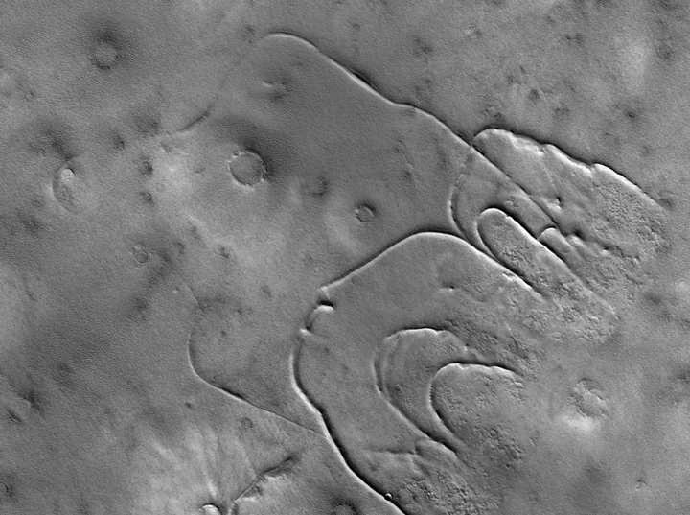
Motivations
At low obliquity, very thin Ar-N₂ atmosphere. Almost all atmospheric CO₂ has condensed
CO₂ glaciers formation ?
Kreslavsky and Head, 2011

Slide 4
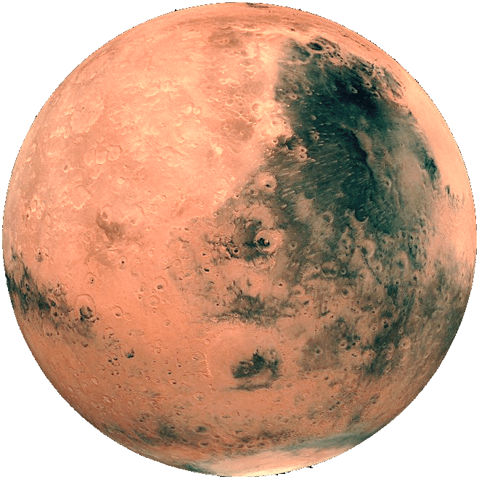
Our experiment
25°
25°
7.5°
15°
25°
0°

Slide 5
Our experiment
25°
15°
7.5°
25°
0°
15°
7.5°
0°
25°
15°
7.5°
0°

Slide 6
Our experiment
25°
15°
7.5°
0°

Slide 7
CO₂ ice

Slide 8
NO SLOPES

Slide 9

Computing Temperatures with the LMD 1D radiative convective model.
Physical processes taken into account.
Solar
flux
Thermal
IR
Turbulence and convection
dust
dust
dust
CO2
Co2 ice
Heat conduction
Sensible
Heat flux
Latent
Heat flux

Slide 10
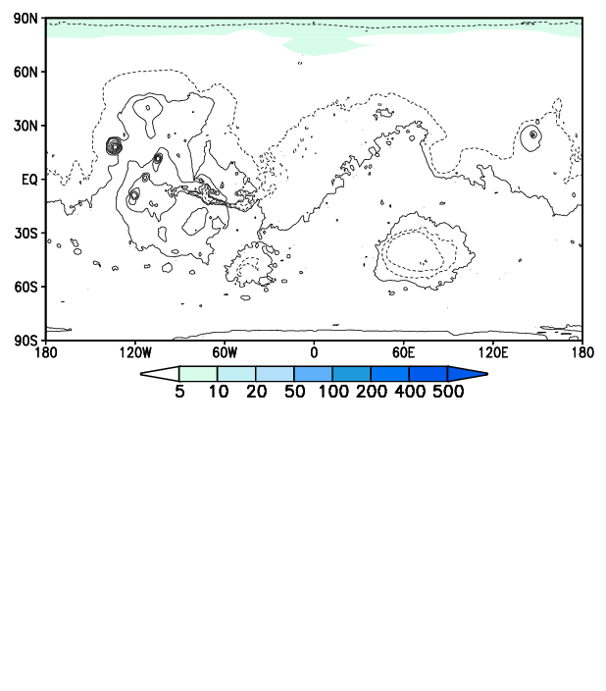
The ‘flat Mars’ experiment

Slide 11
Schemas avec obliquités et code couleur

Slide 12
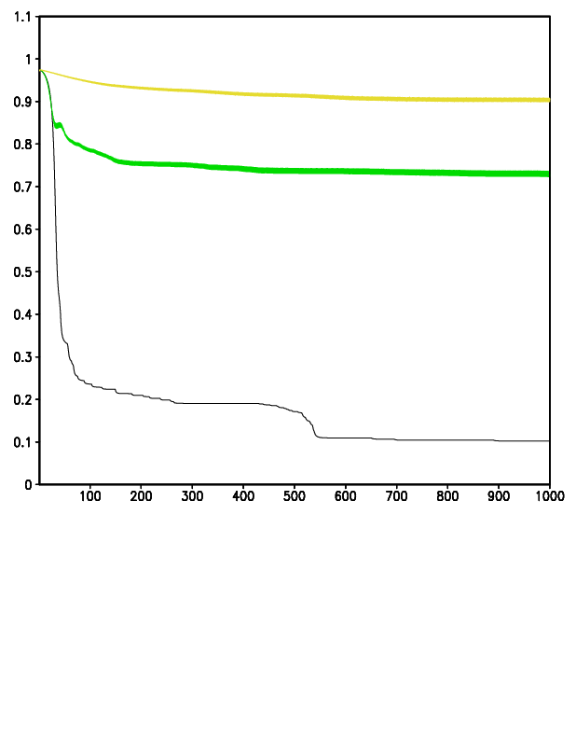
The ‘flat Mars’ experiment

Slide 13
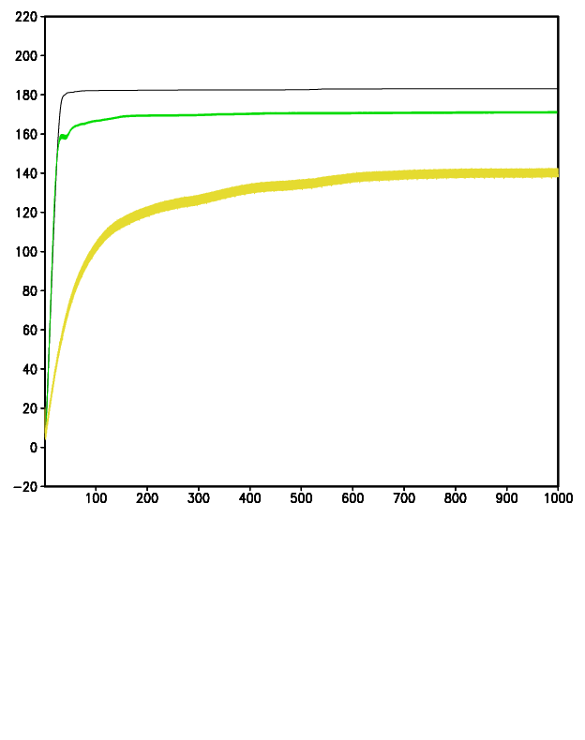
The ‘flat Mars’ experiment

Slide 14
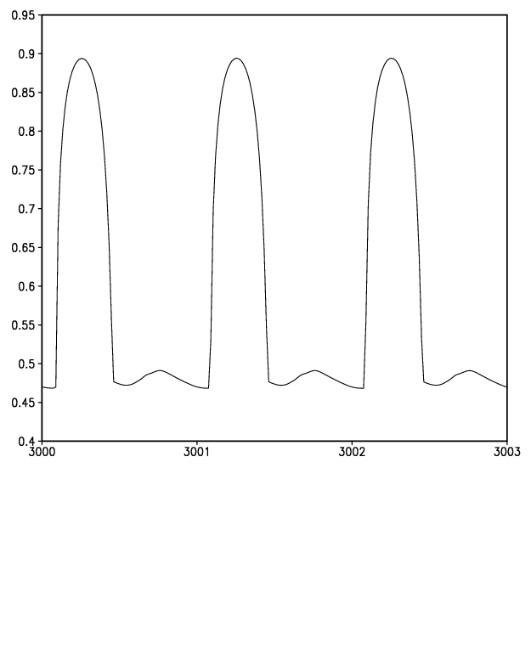
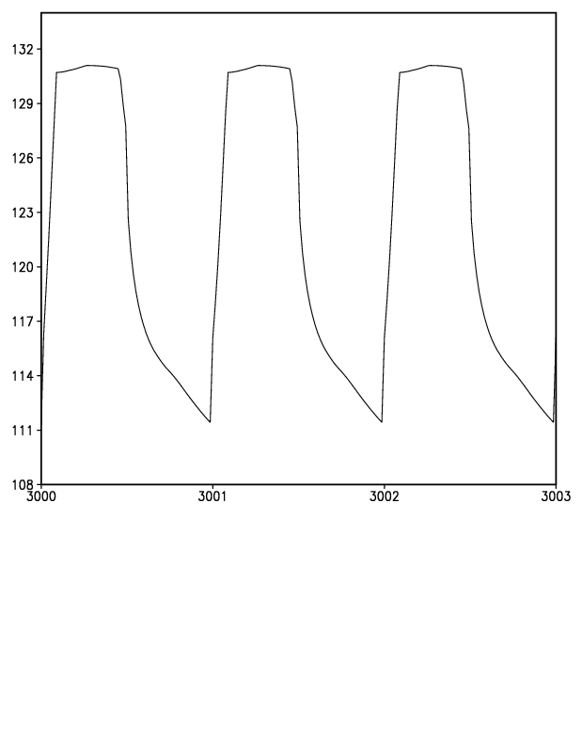
The ‘flat Mars’ experiment
Map avec le point où on regarde

Slide 15
The ‘flat Mars’ experiment

Slide 16
SLOPES

Slide 17
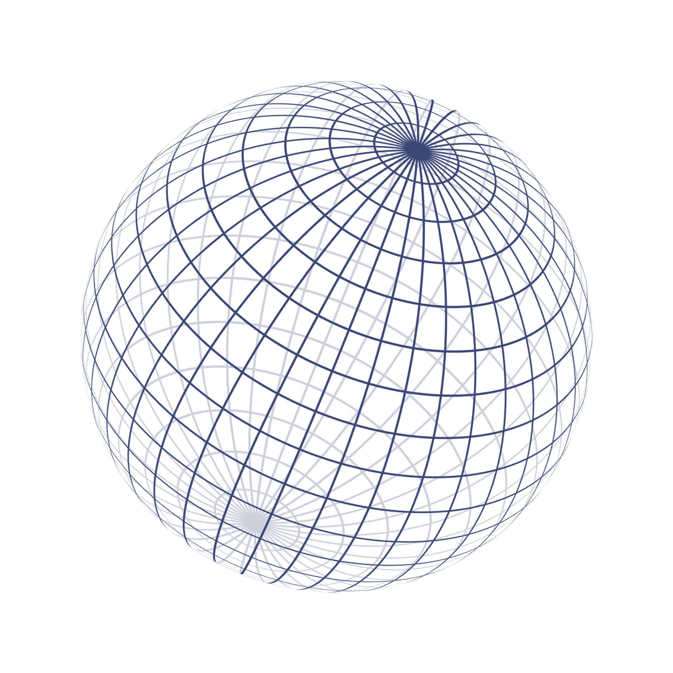
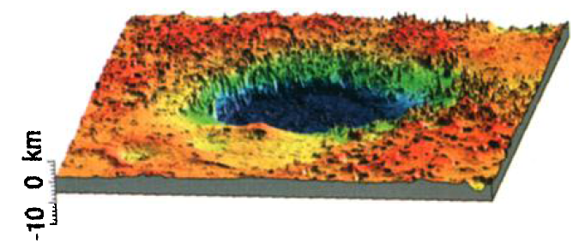

Our tool : a fast climate model
Requirements :
Fast model
Under-mesh slope distribution
Glaciers flow computing

Slide 18
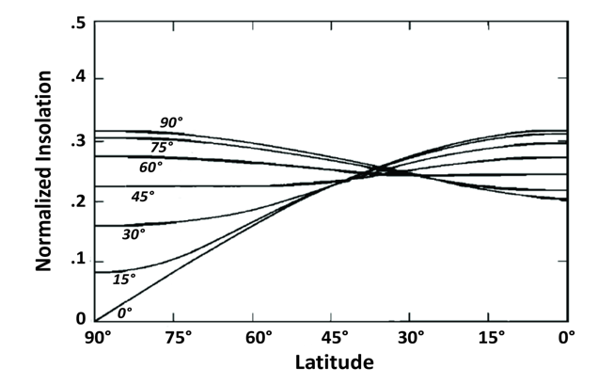
Where does CO₂ condense ?
At the poles ?
Annual insolation for different values of obliquity

Slide 19
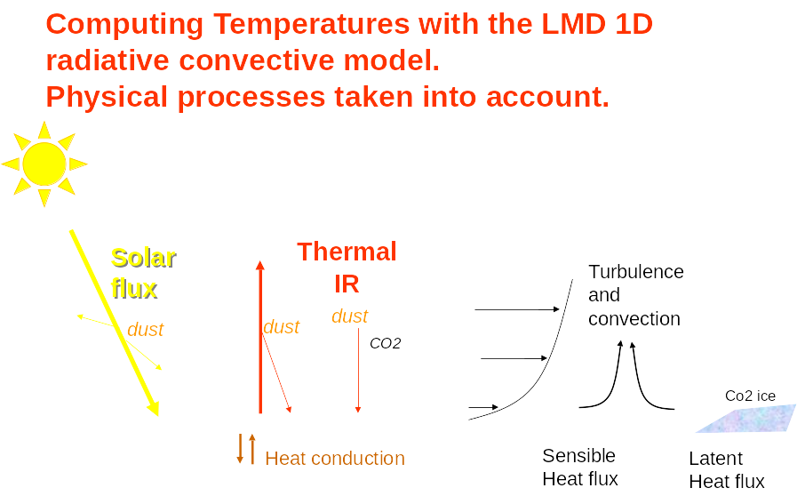
Where does CO₂ condense ?
Importance de la prise en compte des pentes
Slopes must be taken into account

Slide 20
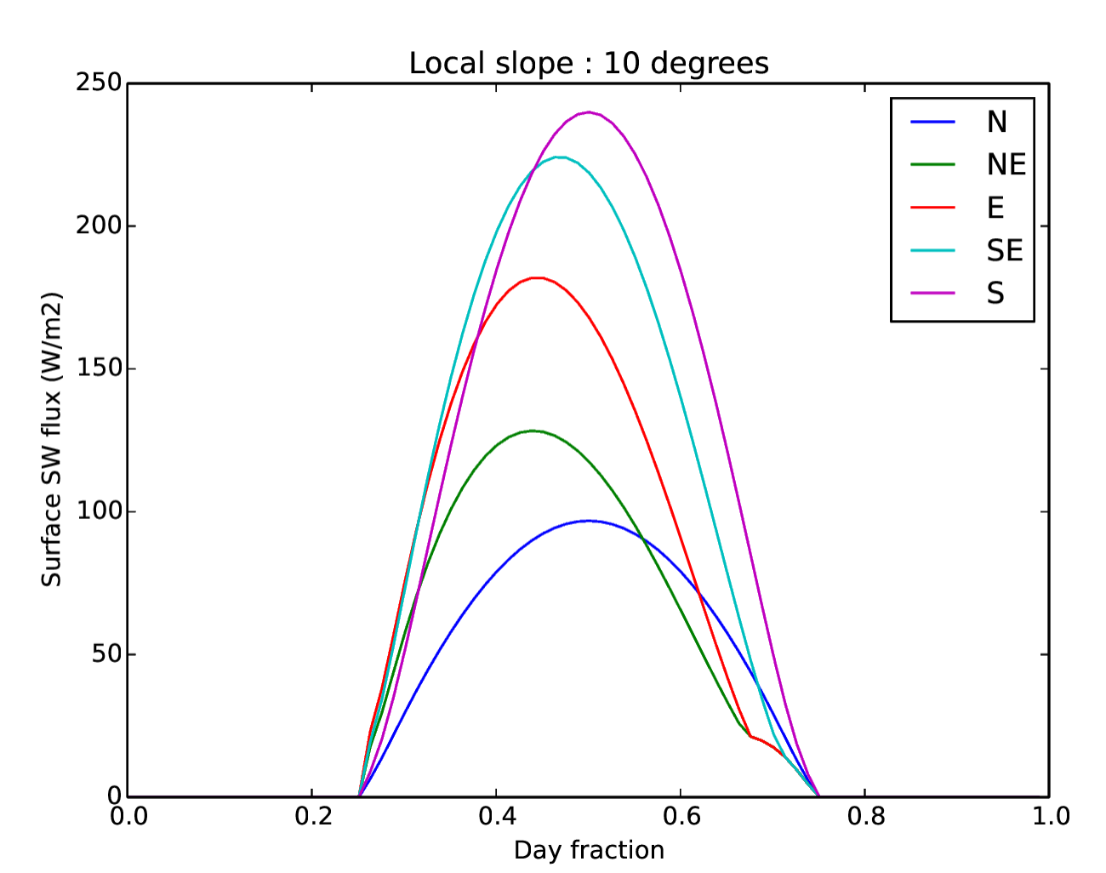
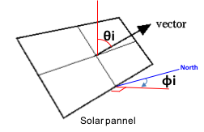
How to describe slopes ?
Inclination : 𝚹
Orientation : ɸ
N
S
Solar flux for different orientations (LMD1D)
Latitude : 70°N
LS(t=0) = 0°

Slide 21
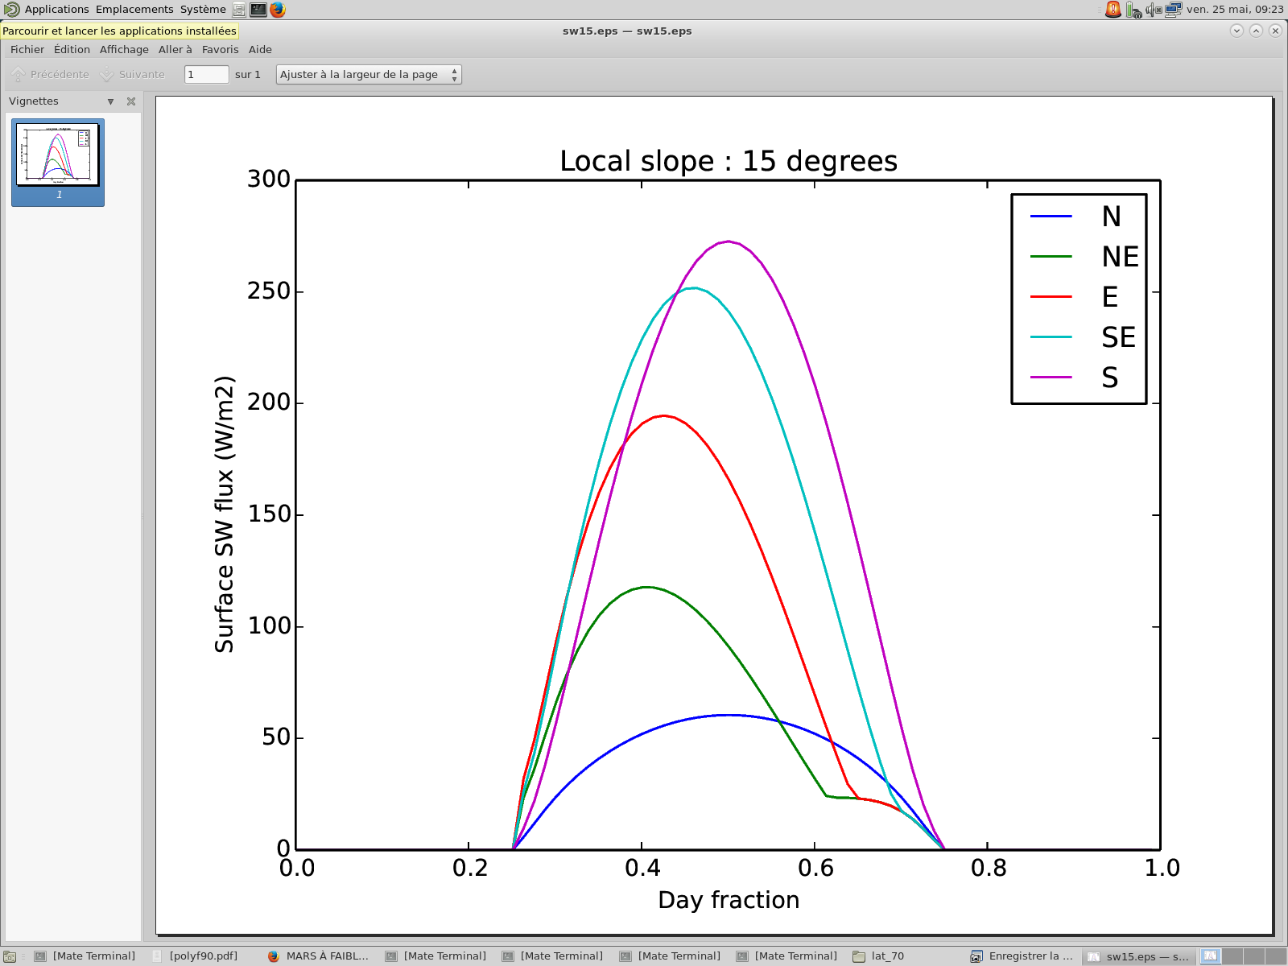
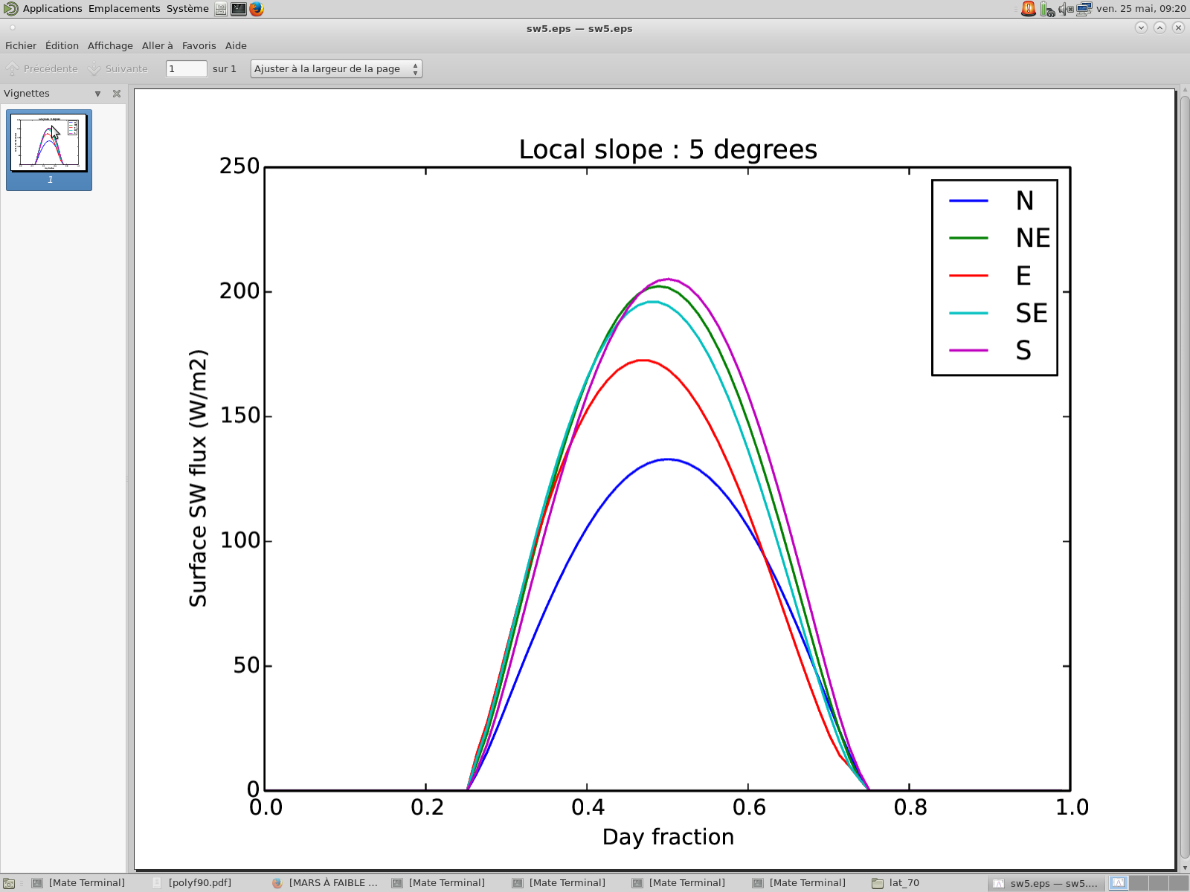
What criteria define the solar flux ?

Slide 22
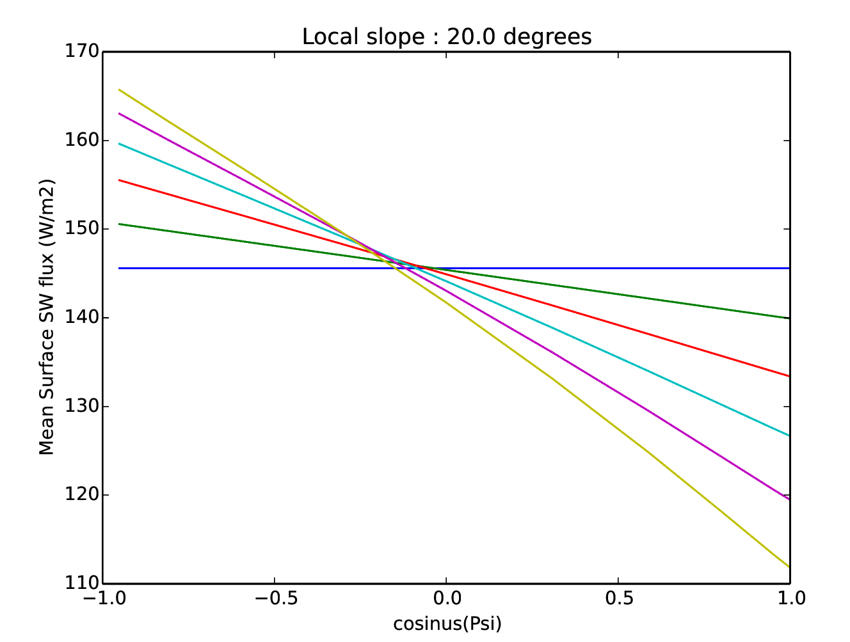
What criteria define the solar flux ?
Inclination : 𝚹
Orientation : ɸ
0°
4°
8°
12°
16°
20°
Mean solar insolation in function of the projection of the orientation on the South-North axis, for different slope inclinations (LMD1D)
Latitude : 30°N
LS(t=0) = 0°

Slide 23
NEW: Simulating the environment on Martian slopes
Calculation of the incident solar flux on any given slope (defined by its slope angle and azimuth) :
Direct flux (non-scattered)
Flux scattered by dust
Flux reflected on “nearby” flat surface
Contribution of the thermal infrared fluxes from “nearby” flat surface (assuming same Temperature than on slope)
IR

Slide 24
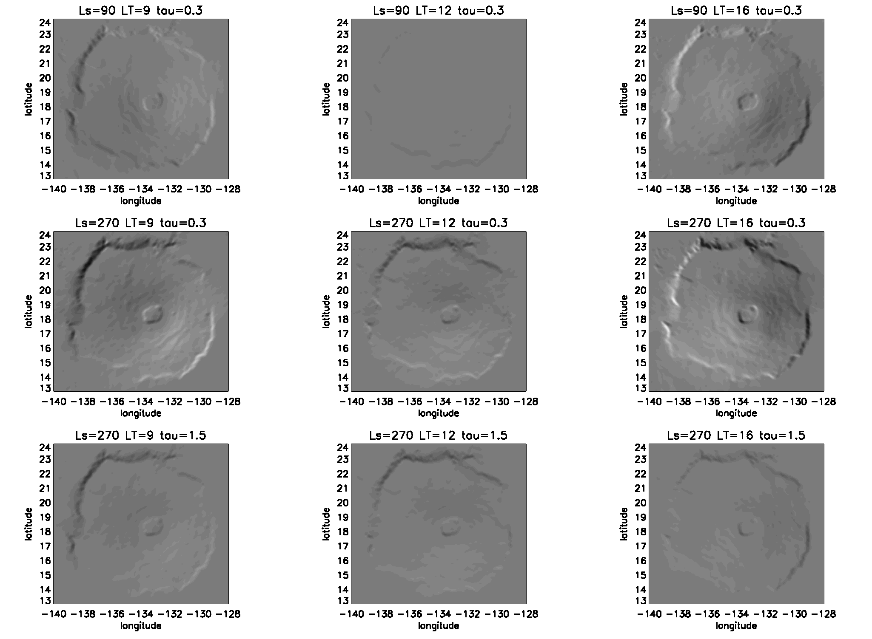
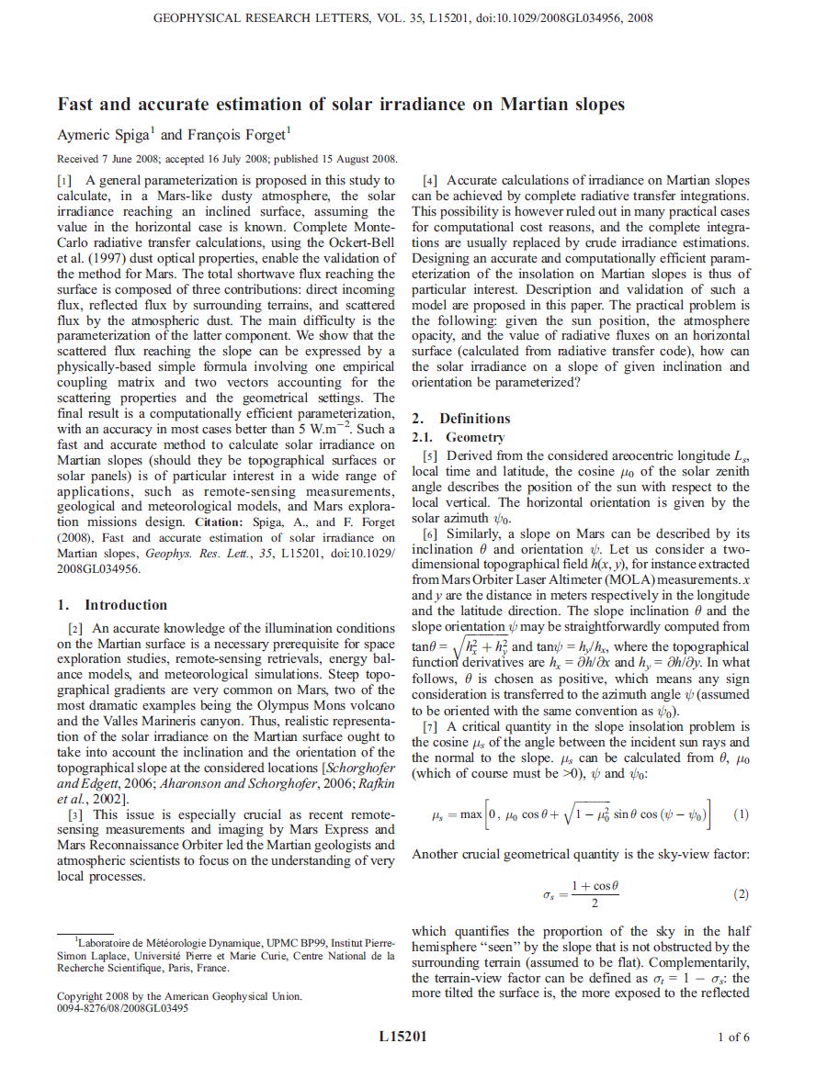
Dust opacity = 0.3 Dust Opacity=1.5
Insolation on slopes derived from Monte-Carlo simulations combined in a dedicated algorithm
(Spiga and Forget, GRL, 2008)

Slide 25
Slopes statistics
Lecture of martian topography (MOLA data)
Computing of local slope inclination / orientation on each MOLA point
Clustering of the slopes according to a specific criterium
Example of application on the whole planet with inclination as slope criterium
Inclination 𝚹 (°) | Ratio (%)
0 ≦ 𝚹 < 4.5 | 94.28
4.5 ≦ 𝚹 < 9 | 3.96
9 ≦ 𝚹 < 13.5 | 1.21
13.5 ≦ 𝚹 | 0.55

Slide 26
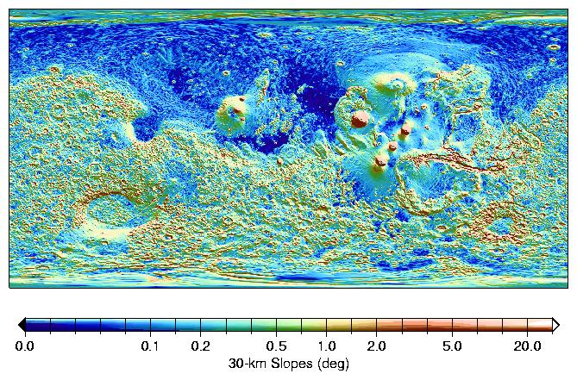
Median slopes on 30-km baselines (from MOLA high resolution datasets)
(Smith et et al. 2001)

Slide 27
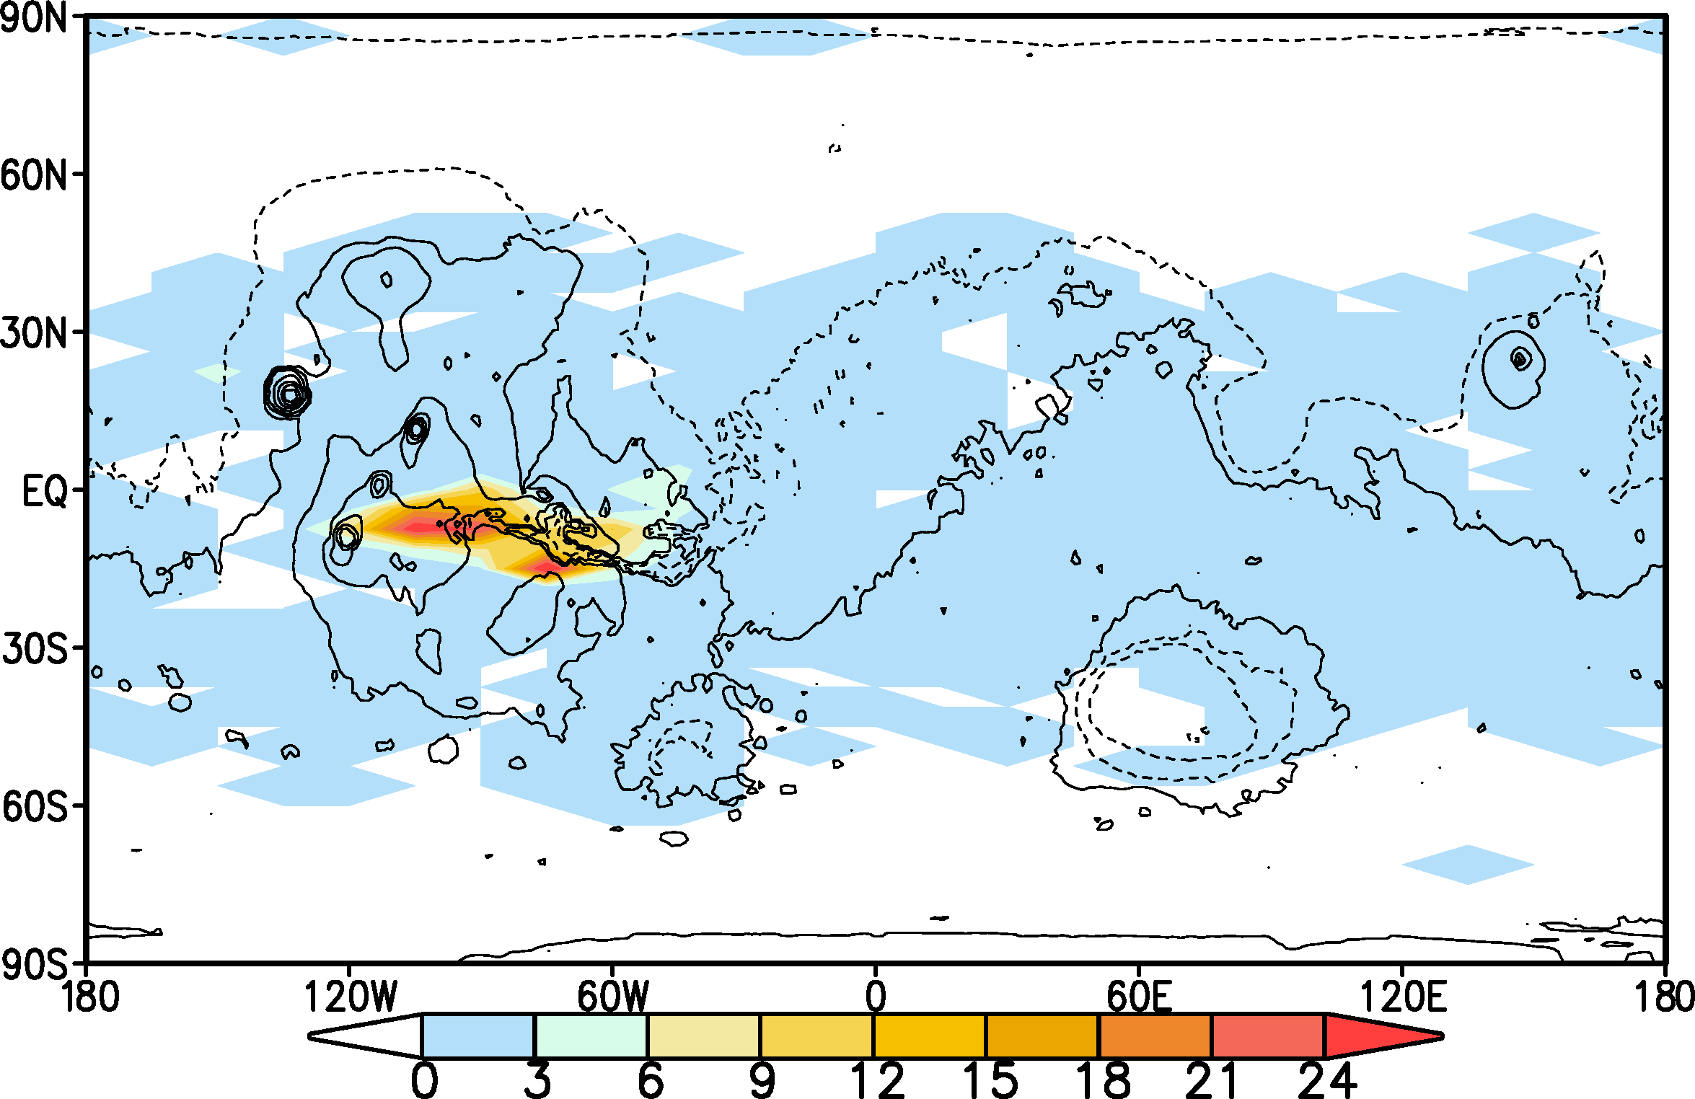
Slopes statistics
SUBSLOPE01 PER1000

Slide 28
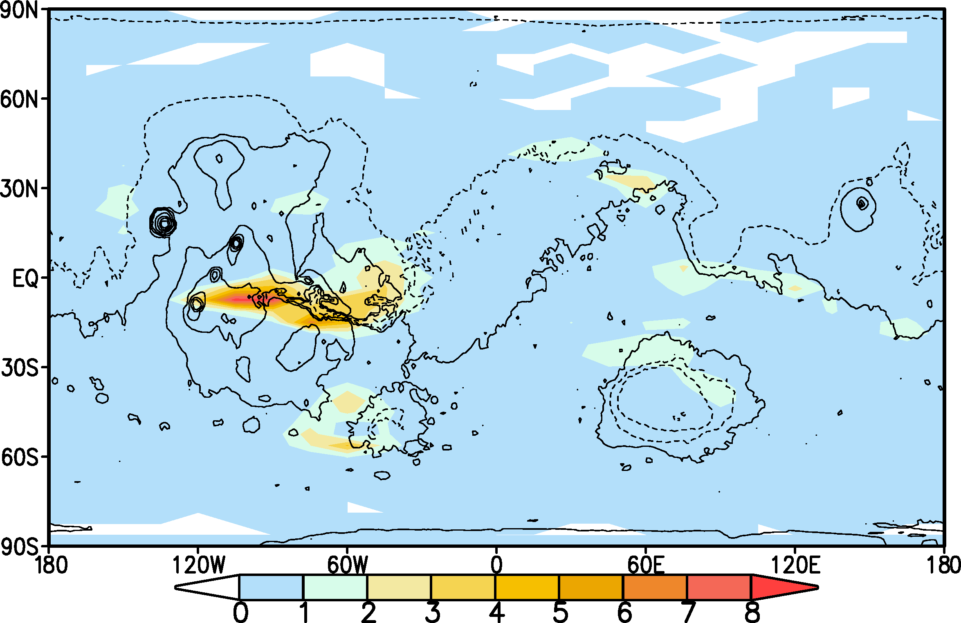
Slopes statistics
SUBSLOPE02 PER100

Slide 29
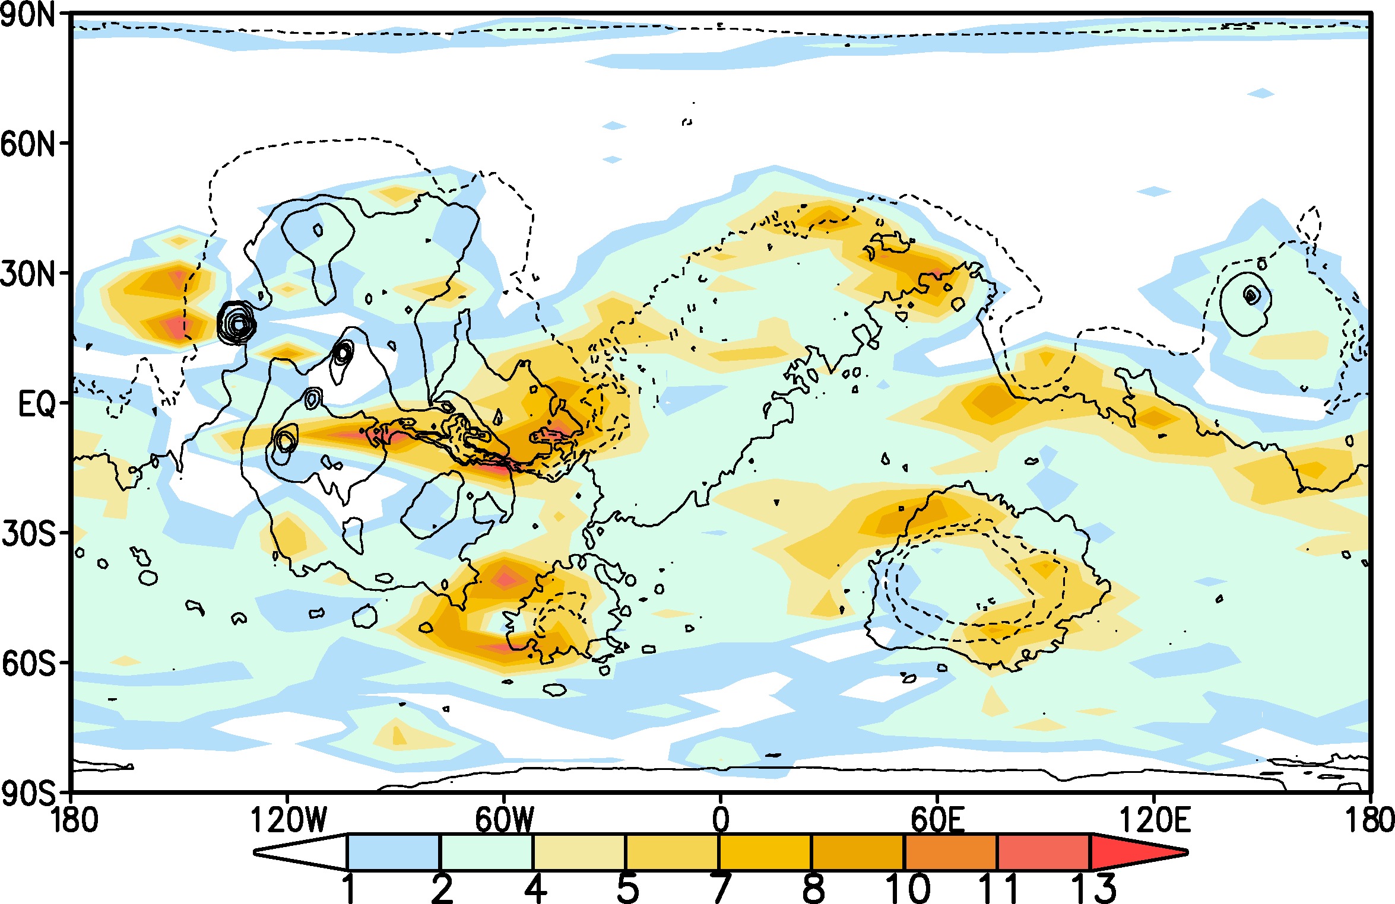
Slopes statistics
SUBSLOPE03 PER100

